Slide 1
Optimizing Hotel Room Pricing for Revenue Maximization
By Vanshita arya

Slide 2


AGENDA
INTRODUCTION
prerequisites
Key pricing drivers identification
Customer segmentation
Demand Forecasting
Impact quantification
summary

Slide 3

INTRO
In this case study, we aim to optimize room pricing for Azure Hotels to maximize revenue. We will analyze various factors that influence pricing and develop a strategy based on customer segmentation and demand forecasting.

Slide 4
Pre-requites
Used Python 3 for the analysis alongwith their special libraries and modules.
Data preparation, Feature engineering, and Data preprocessing performed wherever required.
Model like RandomForestRegressor, K-means clustering, Imputers, used well for the purposely.

Slide 5
Key Pricing Drivers Identification
Method:
‘total nights’ calculation
One-hot encoding
Handles missing values using Imputation
Random Forest Regressor model training
Feature importance Analysis
Results:
Visualized the top 20 pricing drivers using a bar plot.

Slide 6
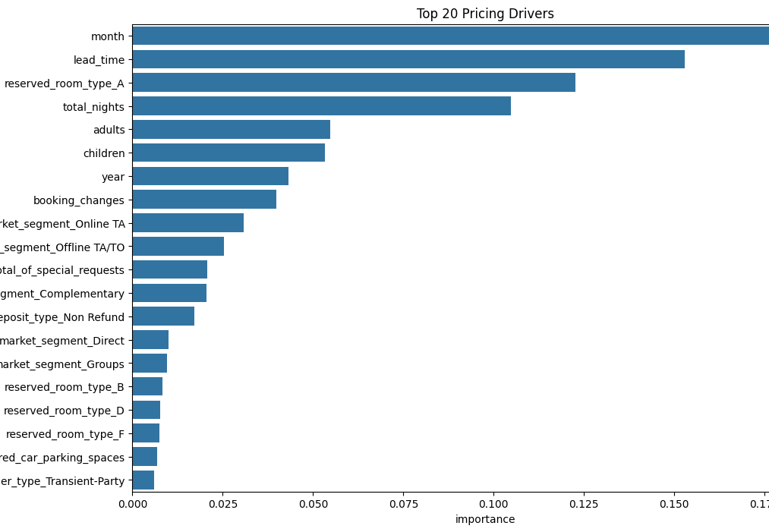

Slide 7
Key pricing drivers & strategies
1. Seasonal Pricing (Month):
Adjust rates higher during peak months
Offer discounts during off-peak times
2. Advanced Booking Strategies (Lead Time)
Implement dynamic pricing based on booking time
Offer early bird discounts or last-minute premium rates
3. Room Type Optimization (Reserved Room Type A):
Adjust pricing for high-value room types
Optimize inventory for these room types
4. Length of Stay Pricing (Total Nights):
Implement tiered pricing for extended stays
Encourage longer bookings with special rates

Slide 8
Customer Segmentation for Targeted Pricing
Method:
Feature selection for Segmentation and ‘total nights’ calculation
Standard Scaler used for standard transformation
K-means clustering to identify customer segments in 4 clusters.
Result:
Customer segment table
Visualize the segments using a scatter plot of total nights vs. ADR.

Slide 9
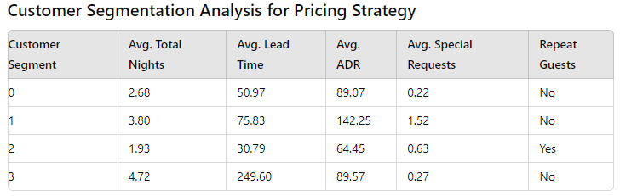

Slide 10
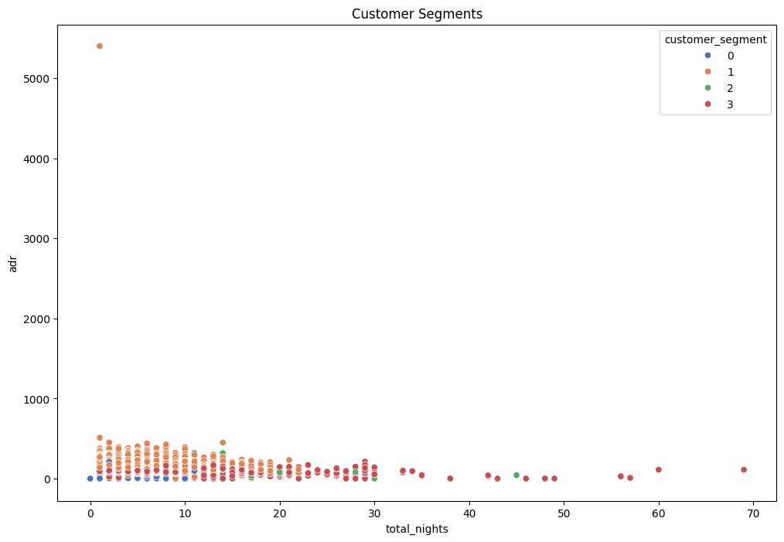

Slide 11
Optimizing Pricing Strategy with Customer Segmentation
1. Targeted Pricing:
Segment 1: Premium packages with added amenities for higher prices.
Segment 2: Loyalty discounts for frequent, short stays.
2. Lead Time Optimization:
Segment 3: Offer early bird discounts for advanced bookings.
Segment 2: Implement last-minute pricing for closer bookings.
3. Length of Stay Strategies:
Segment 3: Discounts for extended stays.
Segment 2: Packages encouraging an extra night.
4. Special Request Management:
Segment 1: Proactively offer premium services at higher rates.

Slide 12
Demand Forecasting Model
Method:
Chosen relevant features
One-hot encoding for categorical variable
Handling missing values
Demand forecast model using Random Forest Regressor
Optimal price calculation with base price and demand elasticity
Result:
Visualization of Current vs Optimal Price using scatter plot

Slide 13
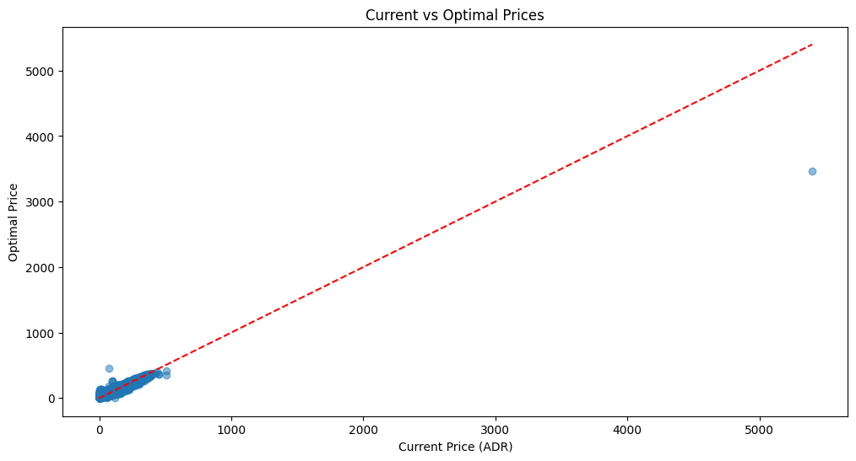
Current vs Optimal Prices

Slide 14
Strategy for revenue & price management
The outliers indicate opportunities where current prices are much lower than they should be. By adjusting these prices closer to the optimal values, you could increase revenue without negatively impacting demand.
Maintain Current Pricing for Most Products: Since most data points are already close to the optimal prices, it may be wise to maintain current pricing strategies for these items. This suggests that the business is already optimizing well in these areas.
Monitor customer response and adjust as necessary: Regularly review prices to ensure they remain close to the optimal levels, particularly in fast-moving or highly competitive markets.

Slide 15
Impact Quantification
Result:
Current Total Revenue: $42,723,497.53
Optimal Total Revenue: $42,776,190.74
Potential Revenue Increase: 0.12%
Current Estimated Profit: $25,634,098.52
Optimal Estimated Profit: $25,665,714.44
Potential Profit Increase: 0.12%
Visualize the distribution of current vs. optimal revenue.
Table representing Revenue Impact by Customer Segment.
Visualization of Revenue Increase by Customer Segment using Bar chart.
Method:
Revenue calculation current_revenue = adr×total_nights optimal_revenue = optimal_price×total_nights
Profit Analysis Profit Margin: 60% current_profit=total_current_revenue×profit_margin
Optimal Profit Calculation: optimal_profit=total_optimal_revenue×profit_margin

Slide 16
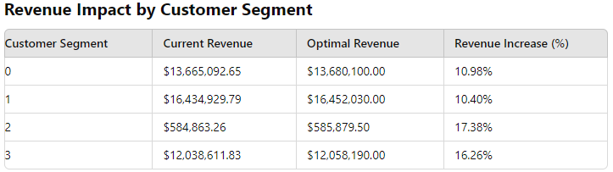

Slide 17
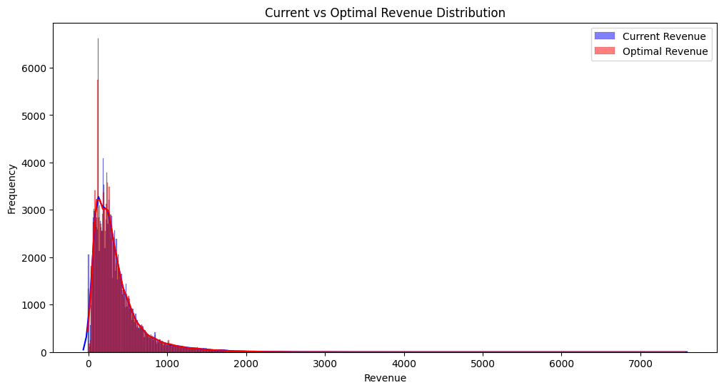

Slide 18
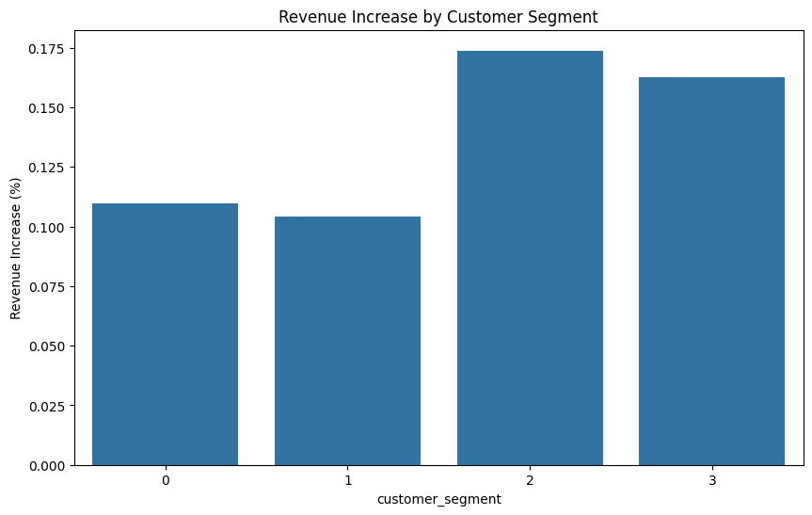

Slide 19
insights for impact quantification
Revenue Distribution:
The current and potential revenues are quite similar, meaning most improvements would come from small tweaks here and there, rather than big changes.
Since the current and potential revenues are so closely aligned, it shows that the business is already doing well, but a little fine-tuning could make it even better.
Customer Segments:
Segment 2 has the most room for improvement. It’s not bringing in as much money right now, but with some targeted strategies, it could perform a lot better.
Segment 3 also shows potential for growth, so it might be worth focusing on it to squeeze out a bit more revenue.
Overall Business Insight:
The small potential increases in revenue and profit suggest that the business is running smoothly. However, there are still chances to make things slightly better, especially by focusing on segments like Segment 2 that aren't performing as well as they could.

Slide 20

SUMMARY
Identified key pricing drivers.
Developed and implemented a dynamic pricing strategy.
Potential revenue and profit increase demonstrated.

Slide 21
THANK YOU
Vanshita Arya
Data Science
vanshita.arya@outlook.com

